Slide 1
Adventures in Chess
Or: Why is the Pawn Still Broken

Slide 2
What is chess?
Simple (yet extraordinarily complex) two player board game
Objective: Capture the other players king
Board is an 8x8 grid
Six different types of pieces with their own move rules
Each player has:
8 Pawns 2 Horses 2 Rooks
2 Bishops 1 Queen 1 King
16 pieces

Slide 3
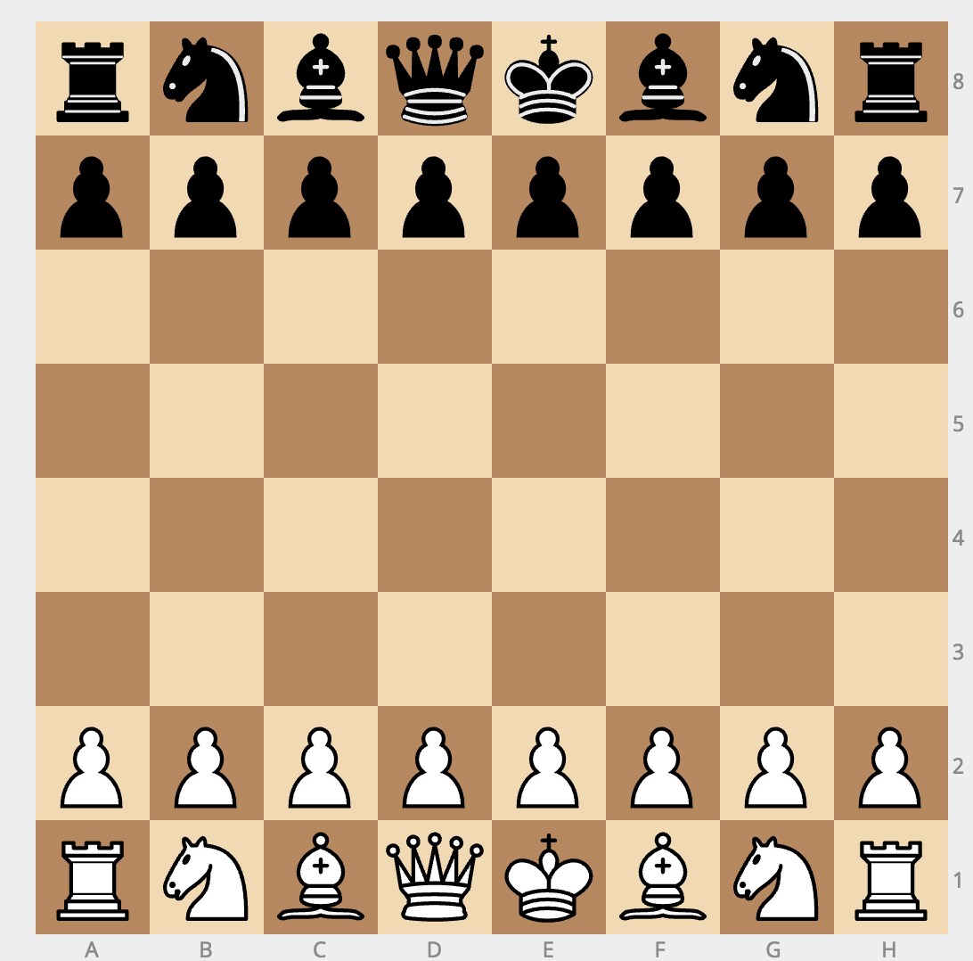
Chess Board
Kill this guy to win

Slide 4
Move Checks
Each piece must pass four move checks in order to move
Can the piece move in that way
Is there a piece in the way
Will it kill your piece
Will it leave your king in check
There are a two smaller check handled higher up
Is your input a position on the board
Do you have a piece at that position

Slide 5
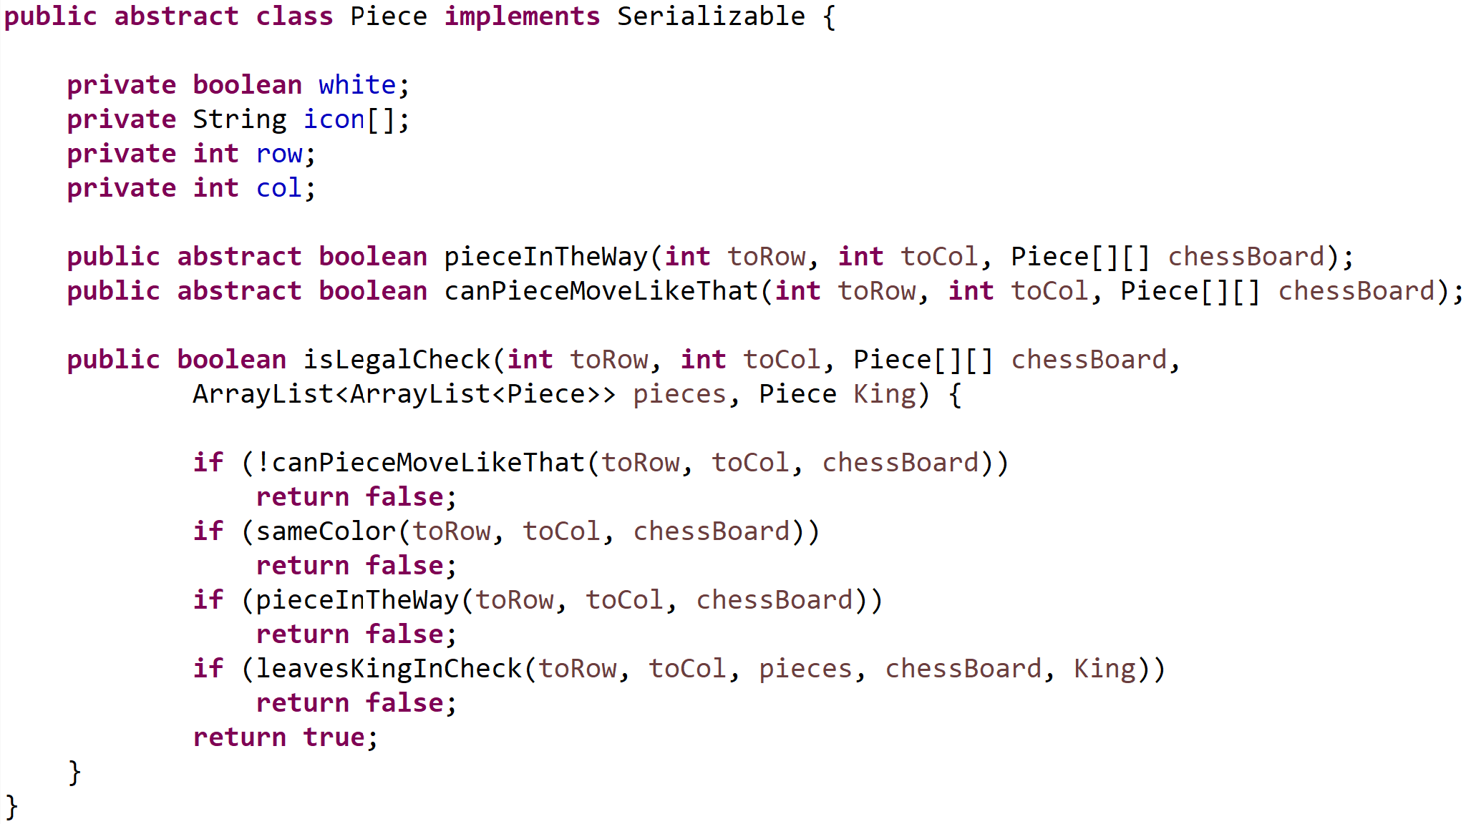
Move Checks
Each piece moves in a unique way
But all need to conform to two important checks
canPieceMoveLikeThat
pieceInTheWay
Use a Piece interface
Allows any piece to have a legal move check

Slide 6
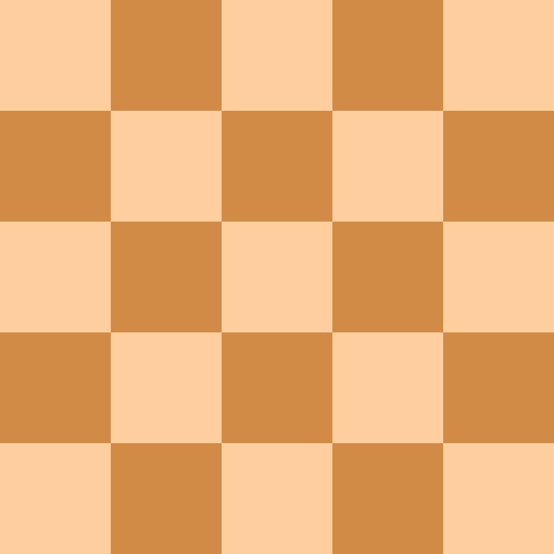

The Rook
Rooks can move in a single axis
Up – Down
Right – Left
It cannot pass over any pieces

Slide 7
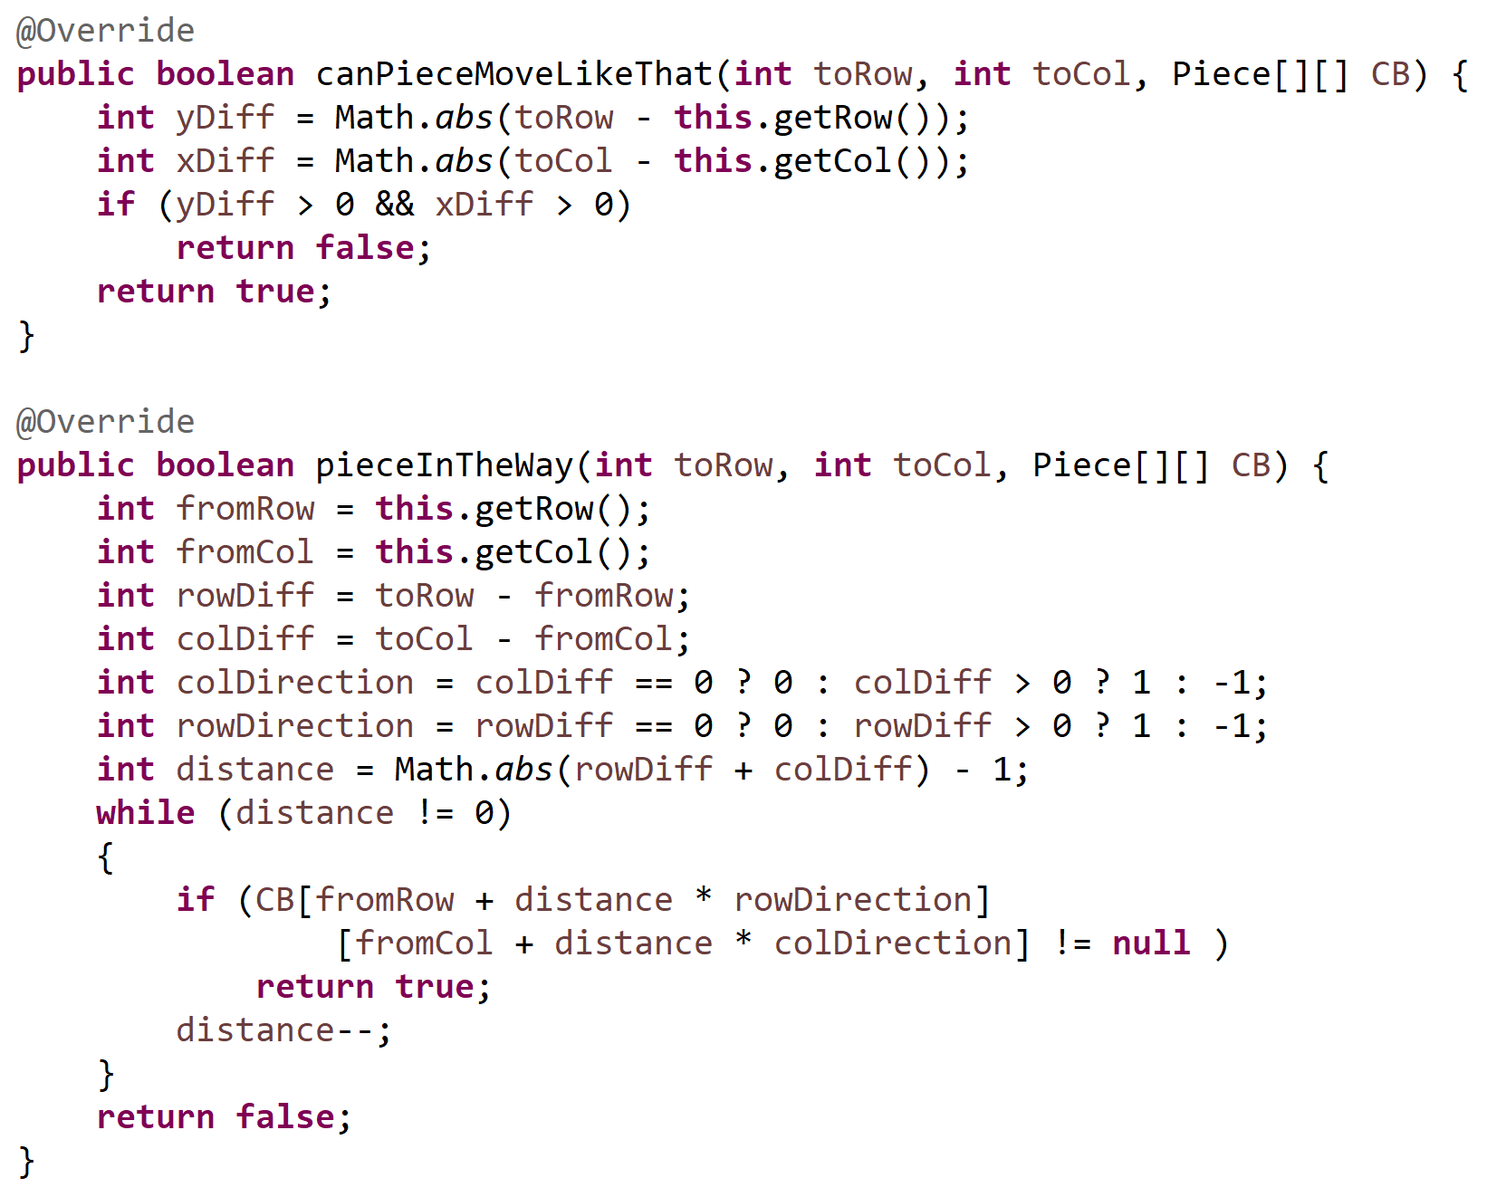
The Rook
canPieceMoveLikeThat
Check if only one axis is changed and the other remained at zero
pieceInTheWay
Theory is simple
Loop through axis and check if anything is in the way
Execution is a little more complex
We use some math tricks to get it down to a single while loop

Slide 8

The Bishop
Bishops can move equally in both axes
It’s essentially a rotated rook
Bottom Left – Top Right
Top Left – Bottom Right
It cannot pass over any pieces

Slide 9
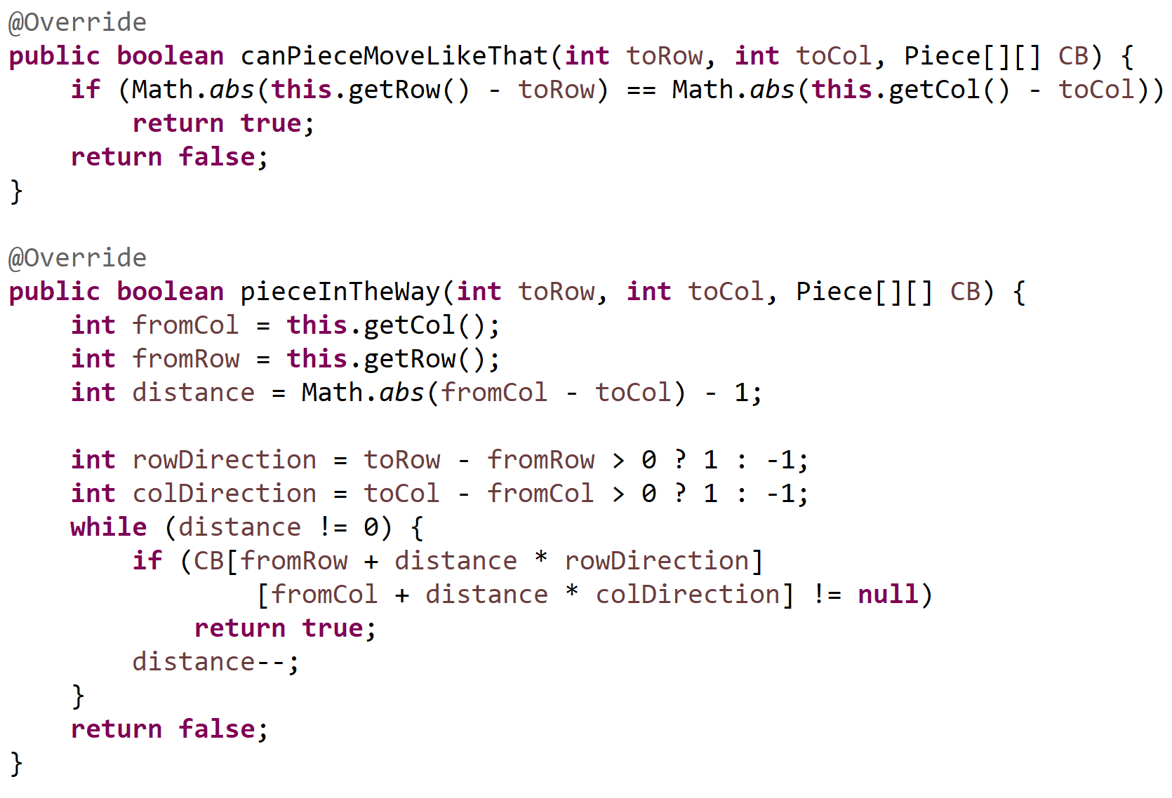
Rooks
canPieceMoveLikeThat
Check if the change in one axis is equal to the change in the other axis
pieceInTheWay
Theory is simple
Loop through both axes and check if anything is in the way
Execution is a little more complex
We use some math tricks to get it down to a single while loop

Slide 10

The queen
The queen can move in four axes
Up – Down
Left – Right
Bottom Left – Top Right
Top Left – Bottom Right
It’s a combination of a rook and bishop
It cannot jump over other pieces

Slide 11
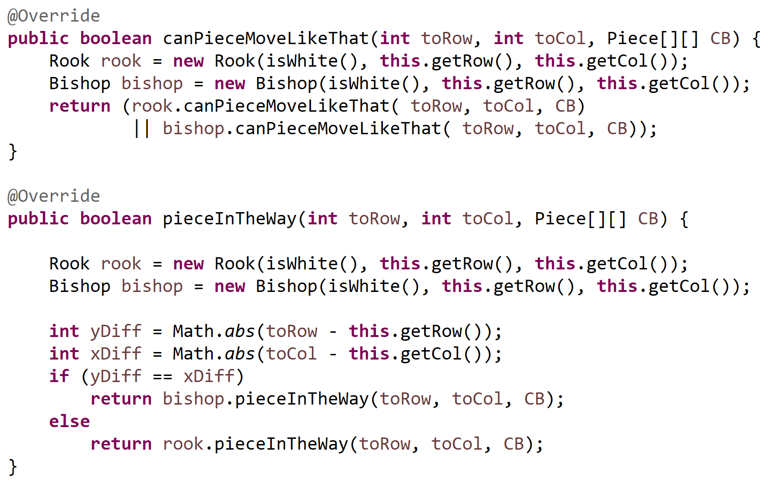
Her majesty
canPieceMoveLikeThat
Can a rook or a bishop move like that?
pieceInTheWay
Depending on how if it’s moving like a bishop or a rook, does it have pieces in the way?

Slide 12

The king
The king has the same move set as the queen, limited to a distance of one
Approaches:
Use a queen and limit it to a distance of one
Check if distance of both the row and column is less than two
Much easier to check the eight immediate spaces surrounding it

Slide 13
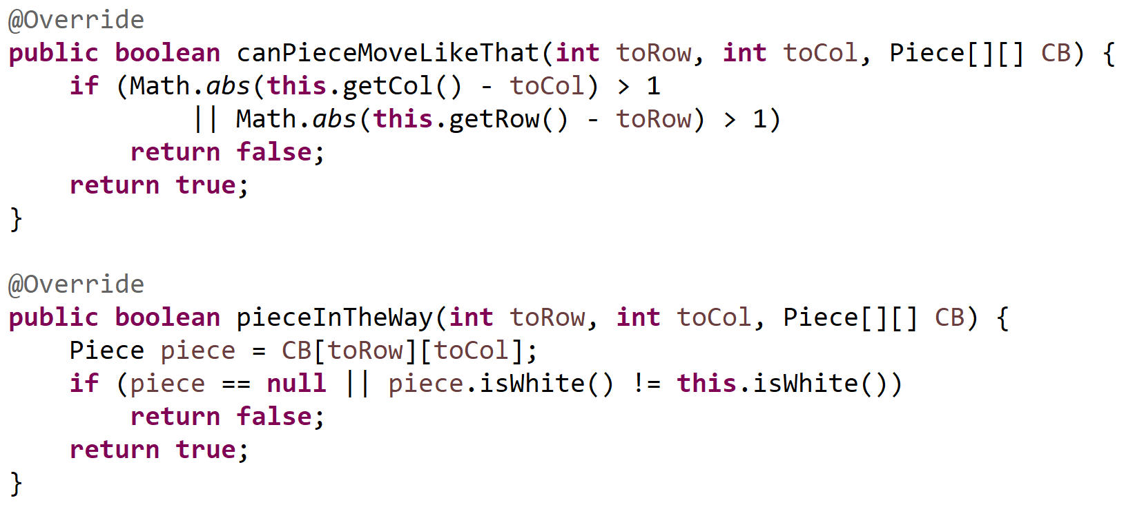
His highness
canPieceMoveLikeThat
Check if the move distance of the row and column is not more than one
pieceInTheWay
If there is no piece there it’s good
If there is, as long as it’s not the same color it’s still good

Slide 14


The horse
Horses have a very interesting move set
One approach is to figure out the weird logic behind it
The easier way is to realize that they are the anti-queen
Wherever a queen can go, they cannot

Slide 15
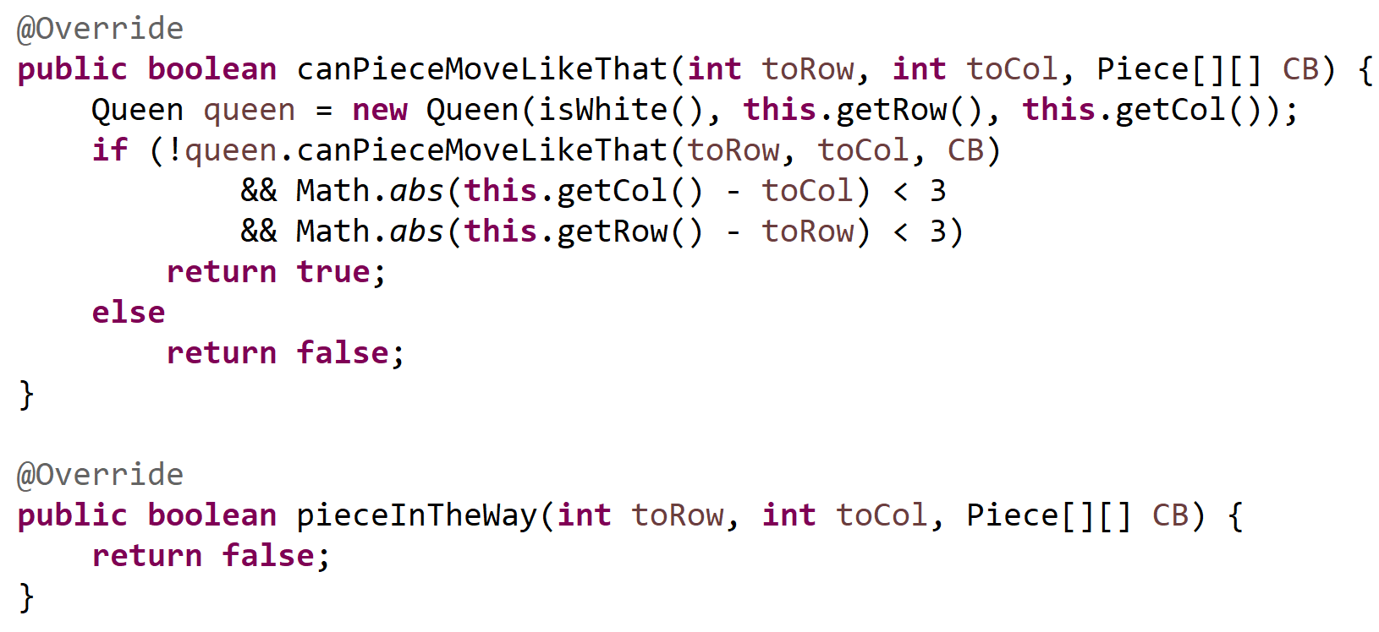
The horse
canPieceMoveLikeThat
1. Make sure a queen cannot move like that
2. Make sure both the column and row distance is less than three
pieceInTheWay
Always returns false because horses can jump

Slide 16


The Pawn
Pawns are weird
Only piece that has differing move rules depending on the circumstances
Normally moves one space forward
On the first move it can move two spaces forward
It can move one diagonal when killing a piece
It can sometimes move diagonal to a empty space if there is a pawn in front of that space

Slide 17
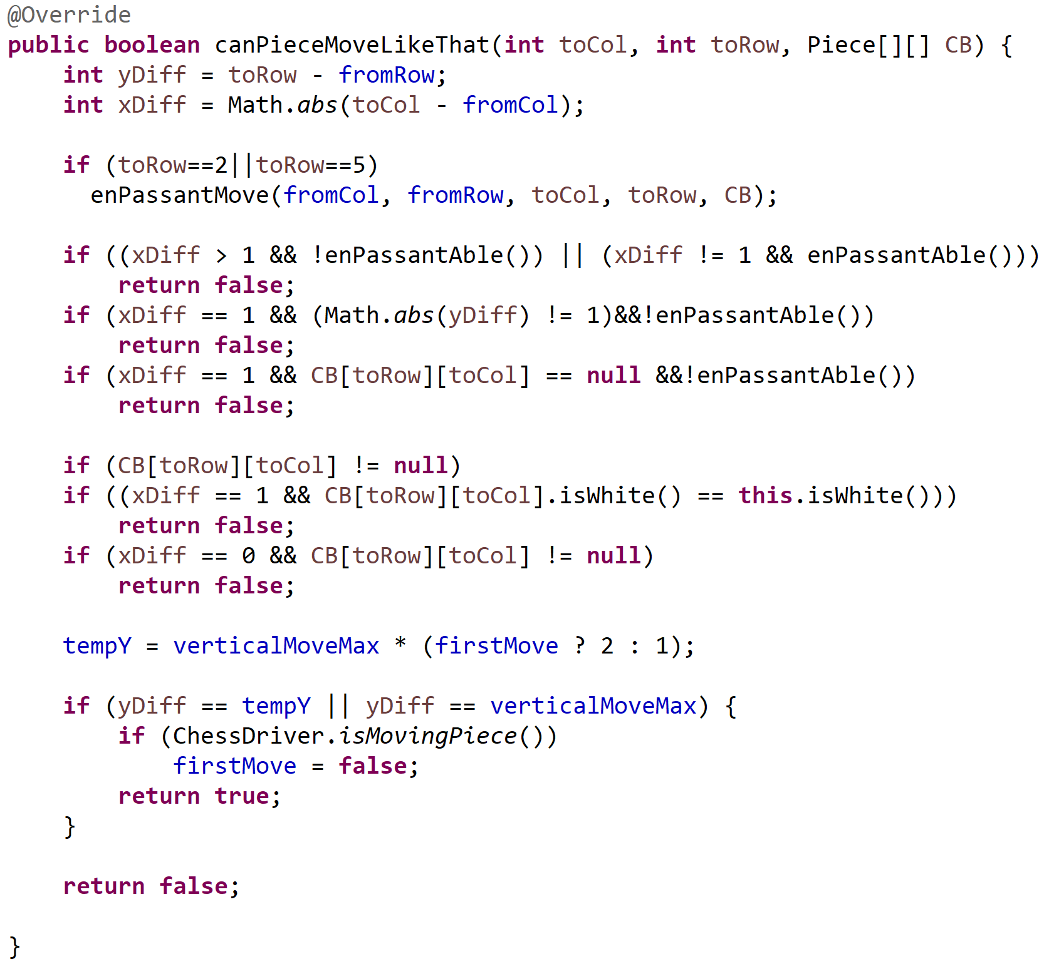
EVIL
The Pawn
First approach:
Code was nearly impossible to follow
Was the result of patches on top of patches
Something was ALWAYS not working correctly
Bugs that didn’t seem possible managed to suddenly exist
Time to change the approach

Slide 18
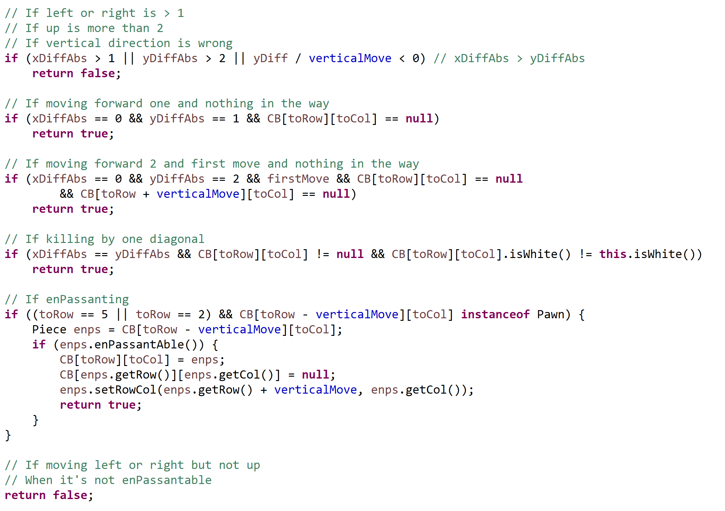

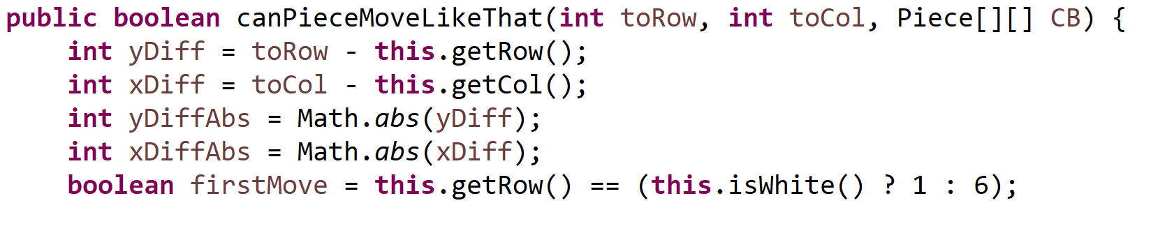
The pawn

Slide 19
The board
We have three different approaches to store the board
Have the pieces hold their row and column
Pros: for inCheck just loop over and see if any pieces can kill the other king
Cons: Displaying the board and move checking requires you to loop over the array 64 times
Two arrays of pieces – one for white & one for black
Pros – Again, makes inCheck easier
Cons – Displaying the board requires an even bigger loop
2D Piece array
Pros: Makes display and move checking much simpler
Cons: O(n^2) for inCheck method – need to loop to find the king, then loop to find opposing pieces

Slide 20
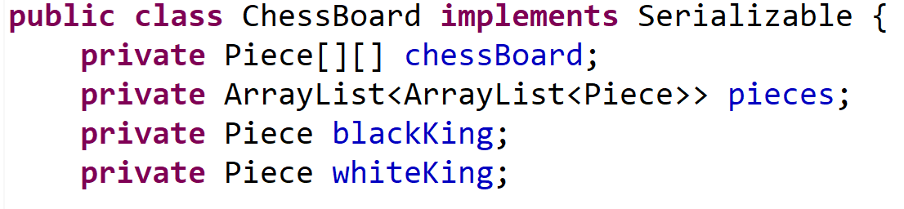
The board
Solution?
Use all three!
Originally all the board variables were kept in the main class
Now everything is handled in a ChessBoard class which holds all the pieces, arrays, variables, etc.

Slide 21
Board Set up
Regular game is hardcoded in
Random game has three steps:
Places a king somewhere in the starting area
Loops over started area and places a random piece
Loops over finished side and copies it for the other player
Loops over board and adds pieces to their respective ArrayList

Slide 22
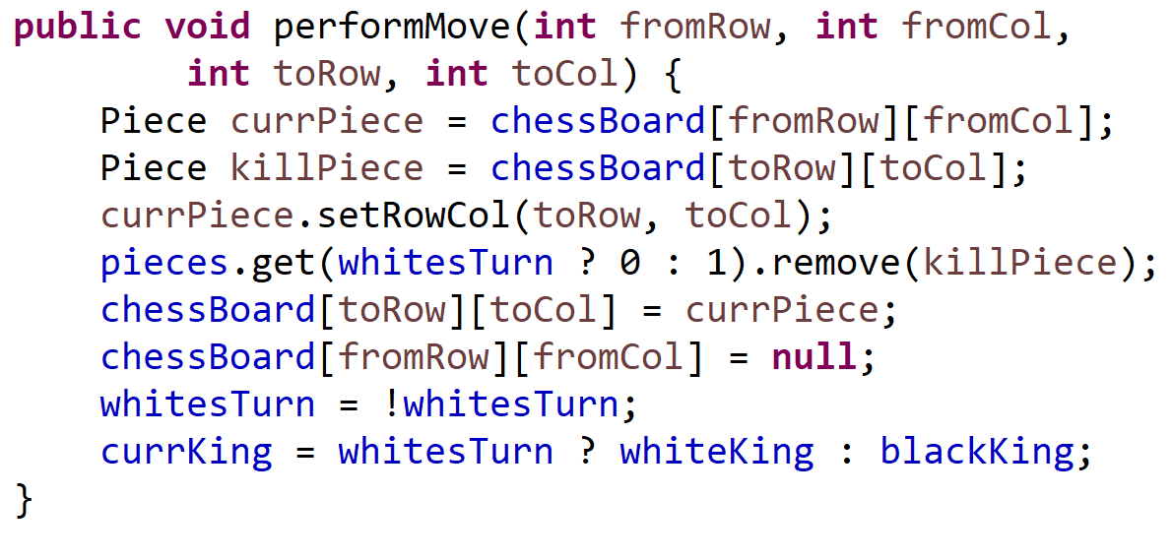
Moving a piece
A few variables must be changed when moving a piece
The moving piece must update it’s internal row and column
We must remove the attacked piece from it’s ArrayList
We need to move the piece in the 2D array
We change the turn and the current king

Slide 23
Game over
After each move we check if the game is over. Either through a checkmate or a stalemate
There are three basic stalemates
A player cannot make any legal moves
Both players only have a kings left
One player only has a king and eighteen moves have passed
Checkmate has two basic parts to it
Check if the king is in check (can any opposing piece attack it)
If it is, can it make any legal moves to take it out of check (if not, checkmate)

Slide 24
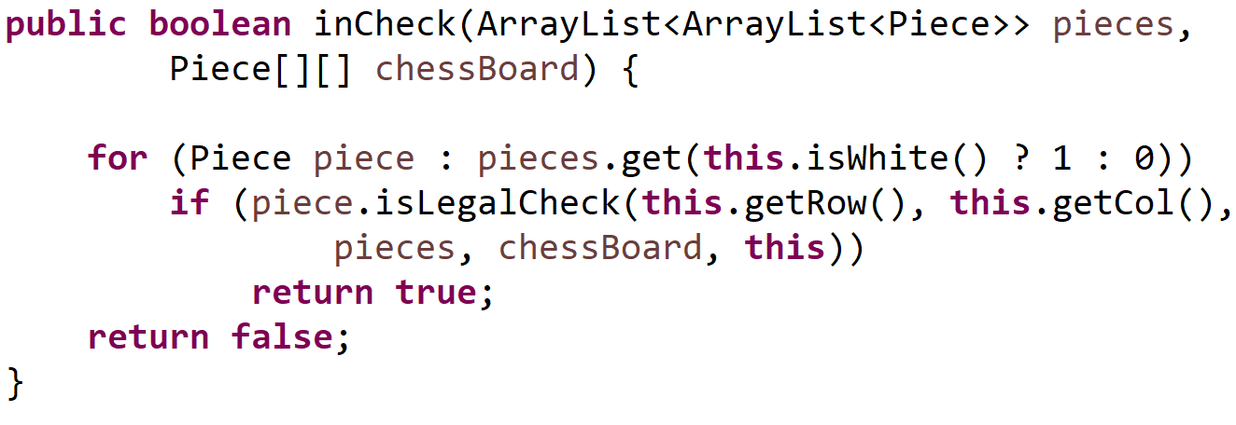
Check for check
Because of our three-way approach to storing the pieces, checking for a check is incredibly easy
Loop over the opposing pieces
Each one tries to kill the king
If it’s able to, check
If not, try the next piece
If all pieces fail, no check

Slide 25
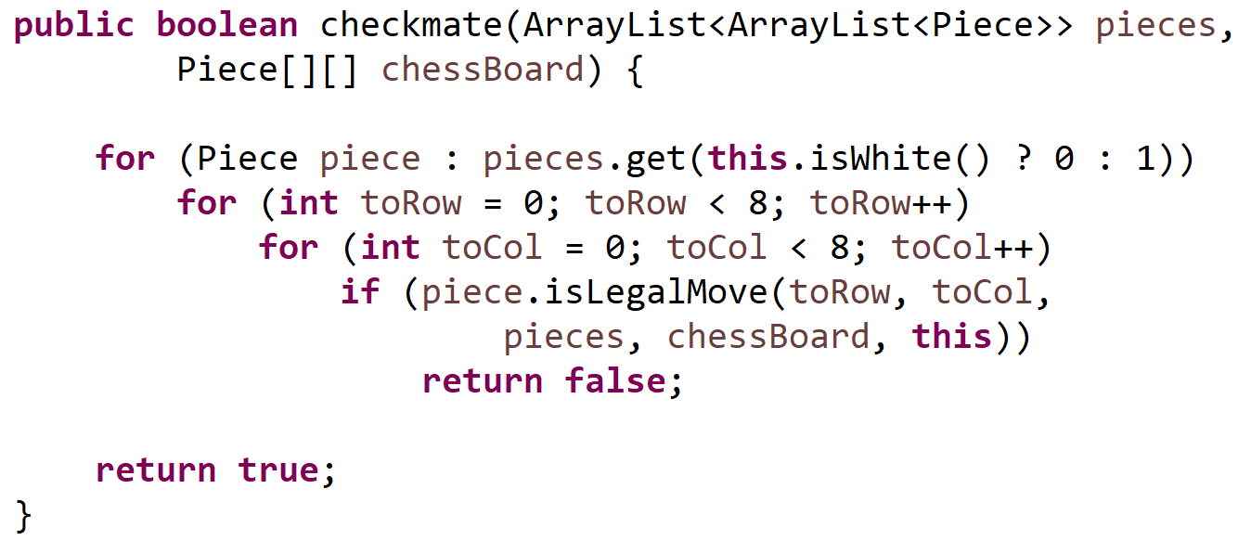
Check for checkmate
Once we’re in check, are we also in checkmate?
No short way to do this
Loop over every piece and attempt to move it all over
Are we still in check?
If not, no checkmate
If yes, try the next piece
Finally, if still yes, checkmate

Slide 26
Selected topics
Artificial Intelligence
Saved Games
Display Methods

Slide 27
Artificial intelligence
After each player makes their first move there are 400 possible positions
After three moves that number jumps to 119,060,324
By the 5th move there are 69,352,859,712,417
Because of this tremendous exponential growth, chess has not been solved
Therefore a perfect computer game is infeasible
We can create an artificial intelligence
There are basic ones and ones that almost seem intelligent

Slide 28
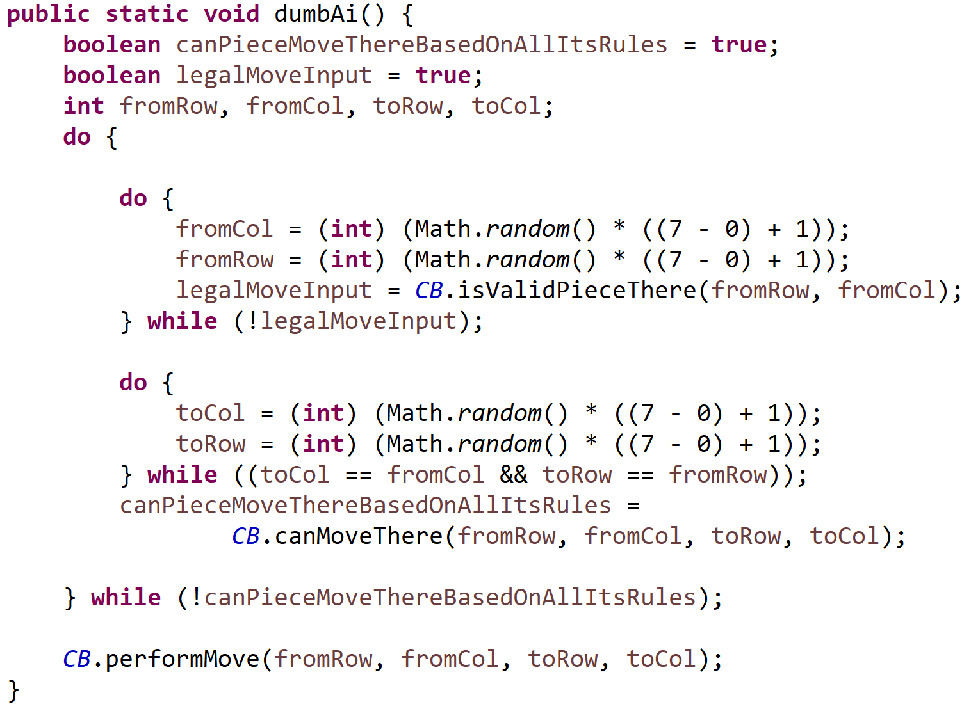
Dumb ai
First method is “dumb”
Completely random
Chooses random legal piece to move
Tries to move it anywhere
Keeps doing this until it finds a legal move
Performs the move

Slide 29
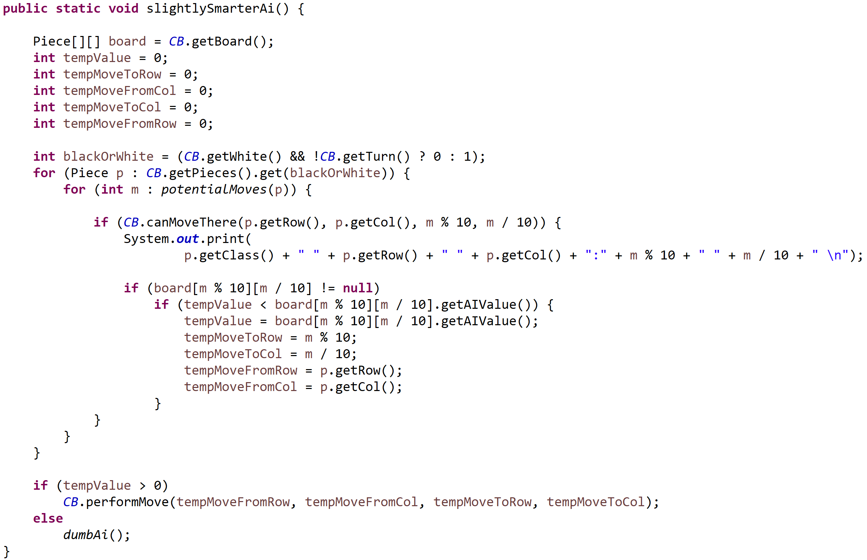
smart ai
Second method is a truer AI
Every piece has a value
The AI tries different moves and gets the total resulting board value
Has a fallback to dumb AI if it cannot figure out a move
An even more advanced version uses recursion

Slide 30
SAVE GAME
One approach is to save all of the variables, arrays, etc.
However, because the ChessBoard object contains all of this can we save the object itself?
If you noticed all the way back when we discussed the ChessBoard, the first line looked like this:
Making the ChessBoard serializable enables us to save the entire object as it is and read it right back when we want to load a game
We now can have a saved game file that contains many games to choose from

Slide 31
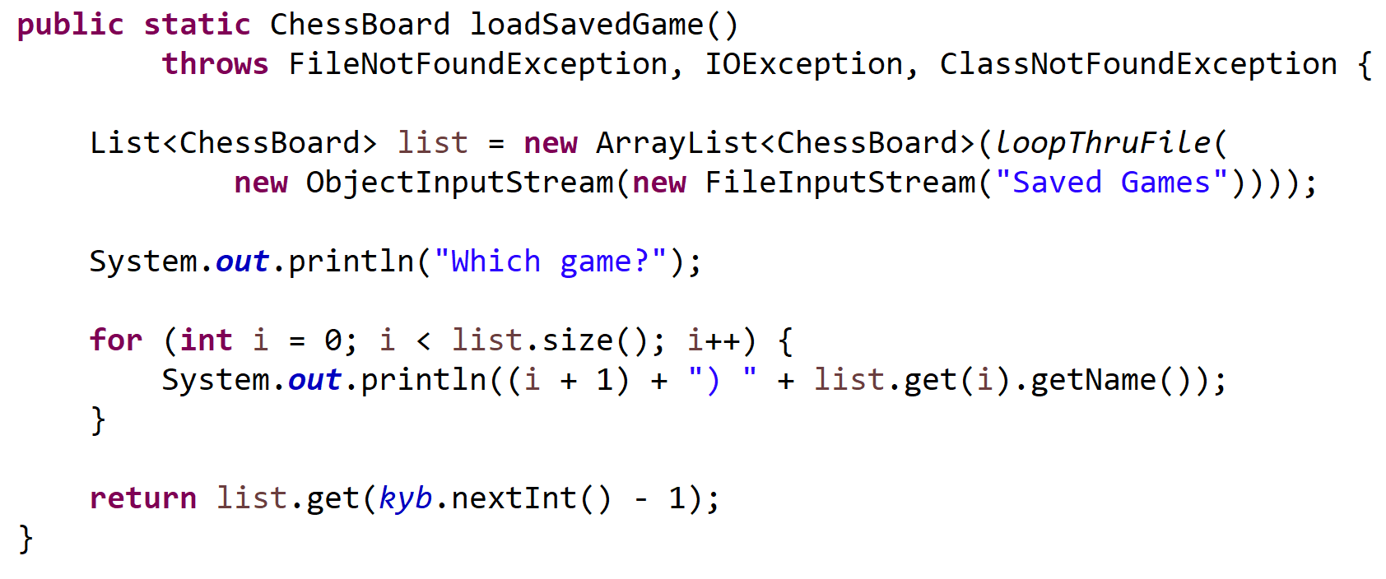
loading
Instead of creating a new ChessBoard, the program reads one from a file
It gets a list of all the saved games in the file
Displays all the choices
Returns the ChessBoard the user wants to use

Slide 32
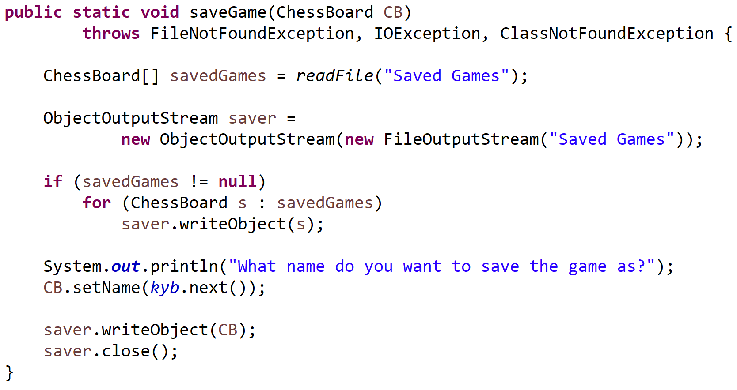
saving
We write the game to a file
Additional games are appended to the file
Actually, you cannot append a binary file
Instead we read in all the saved games to a list
Add the current game
Save the list to the file

Slide 33
DISPLAY
The basic idea is to loop over the 2D array and get all the pieces (leave blank if null)
This works but only for a basic representation of the board
A more complex method is to create a piece “graphic” out of ascii characters
This works but we need to differentiate between white pieces and black pieces
Most modern day CLI’s support 16-bit color (some even 256-bit)
This is perfect but java doesn’t play along so nicely

Slide 34
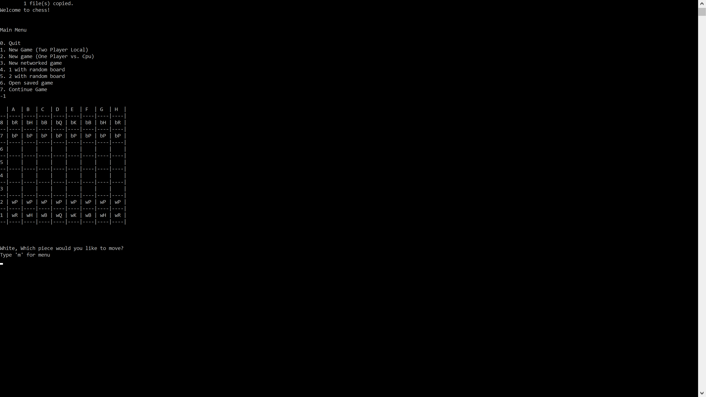
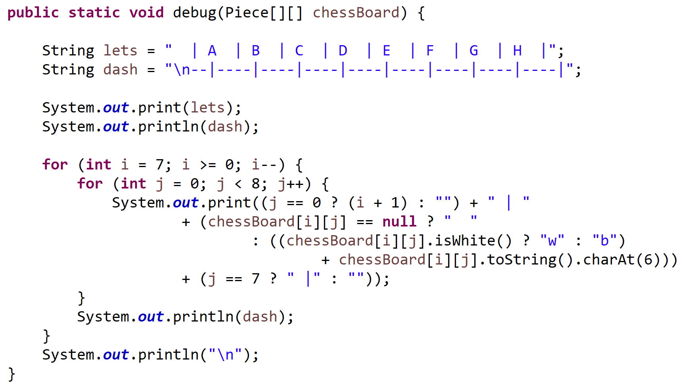
Basic Display
Known as the debug display (easier to use in an IDE)
Create a letter and dash line
Loop over the array and print the pieces
Gives us a representation of the board

Slide 35
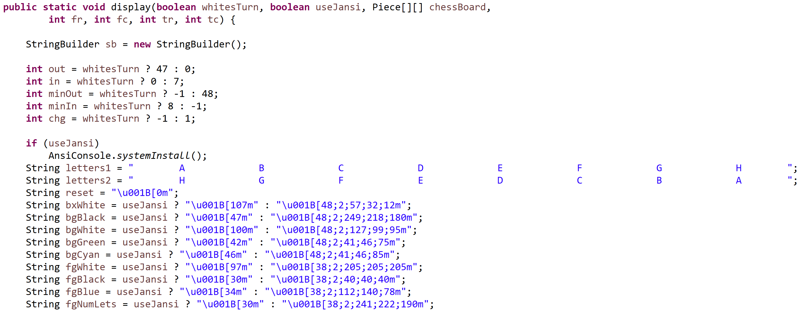
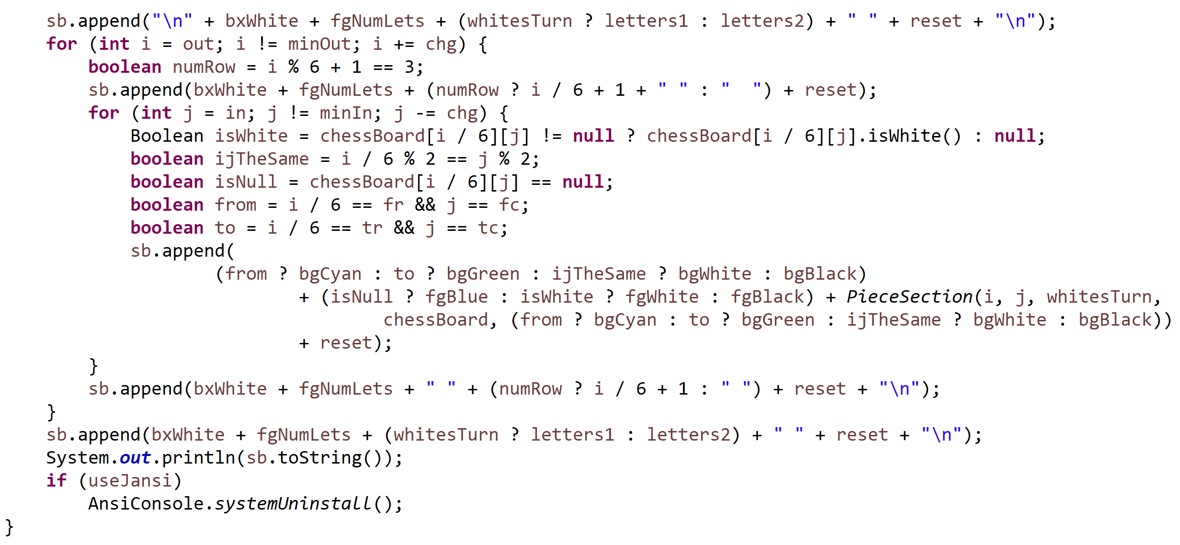
Graphic display
“GUI” display method (simulates a real board)
Use a string builder to contain graphics
Loop over the board, getting the piece graphics
Add number and letter lines
Finally print the board

Slide 36
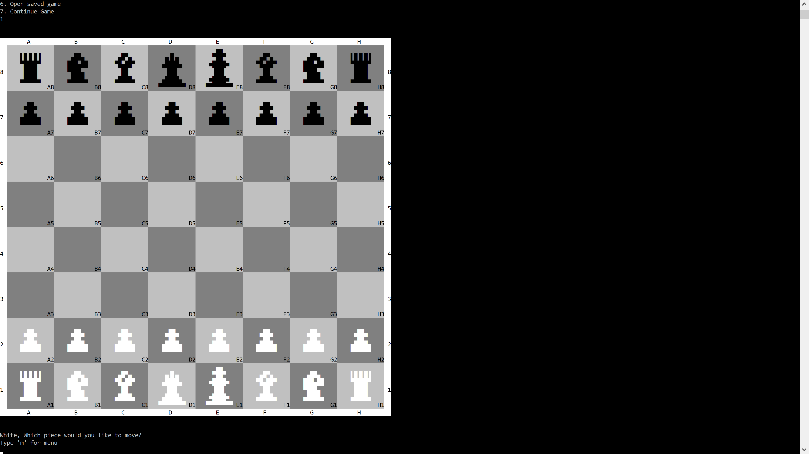
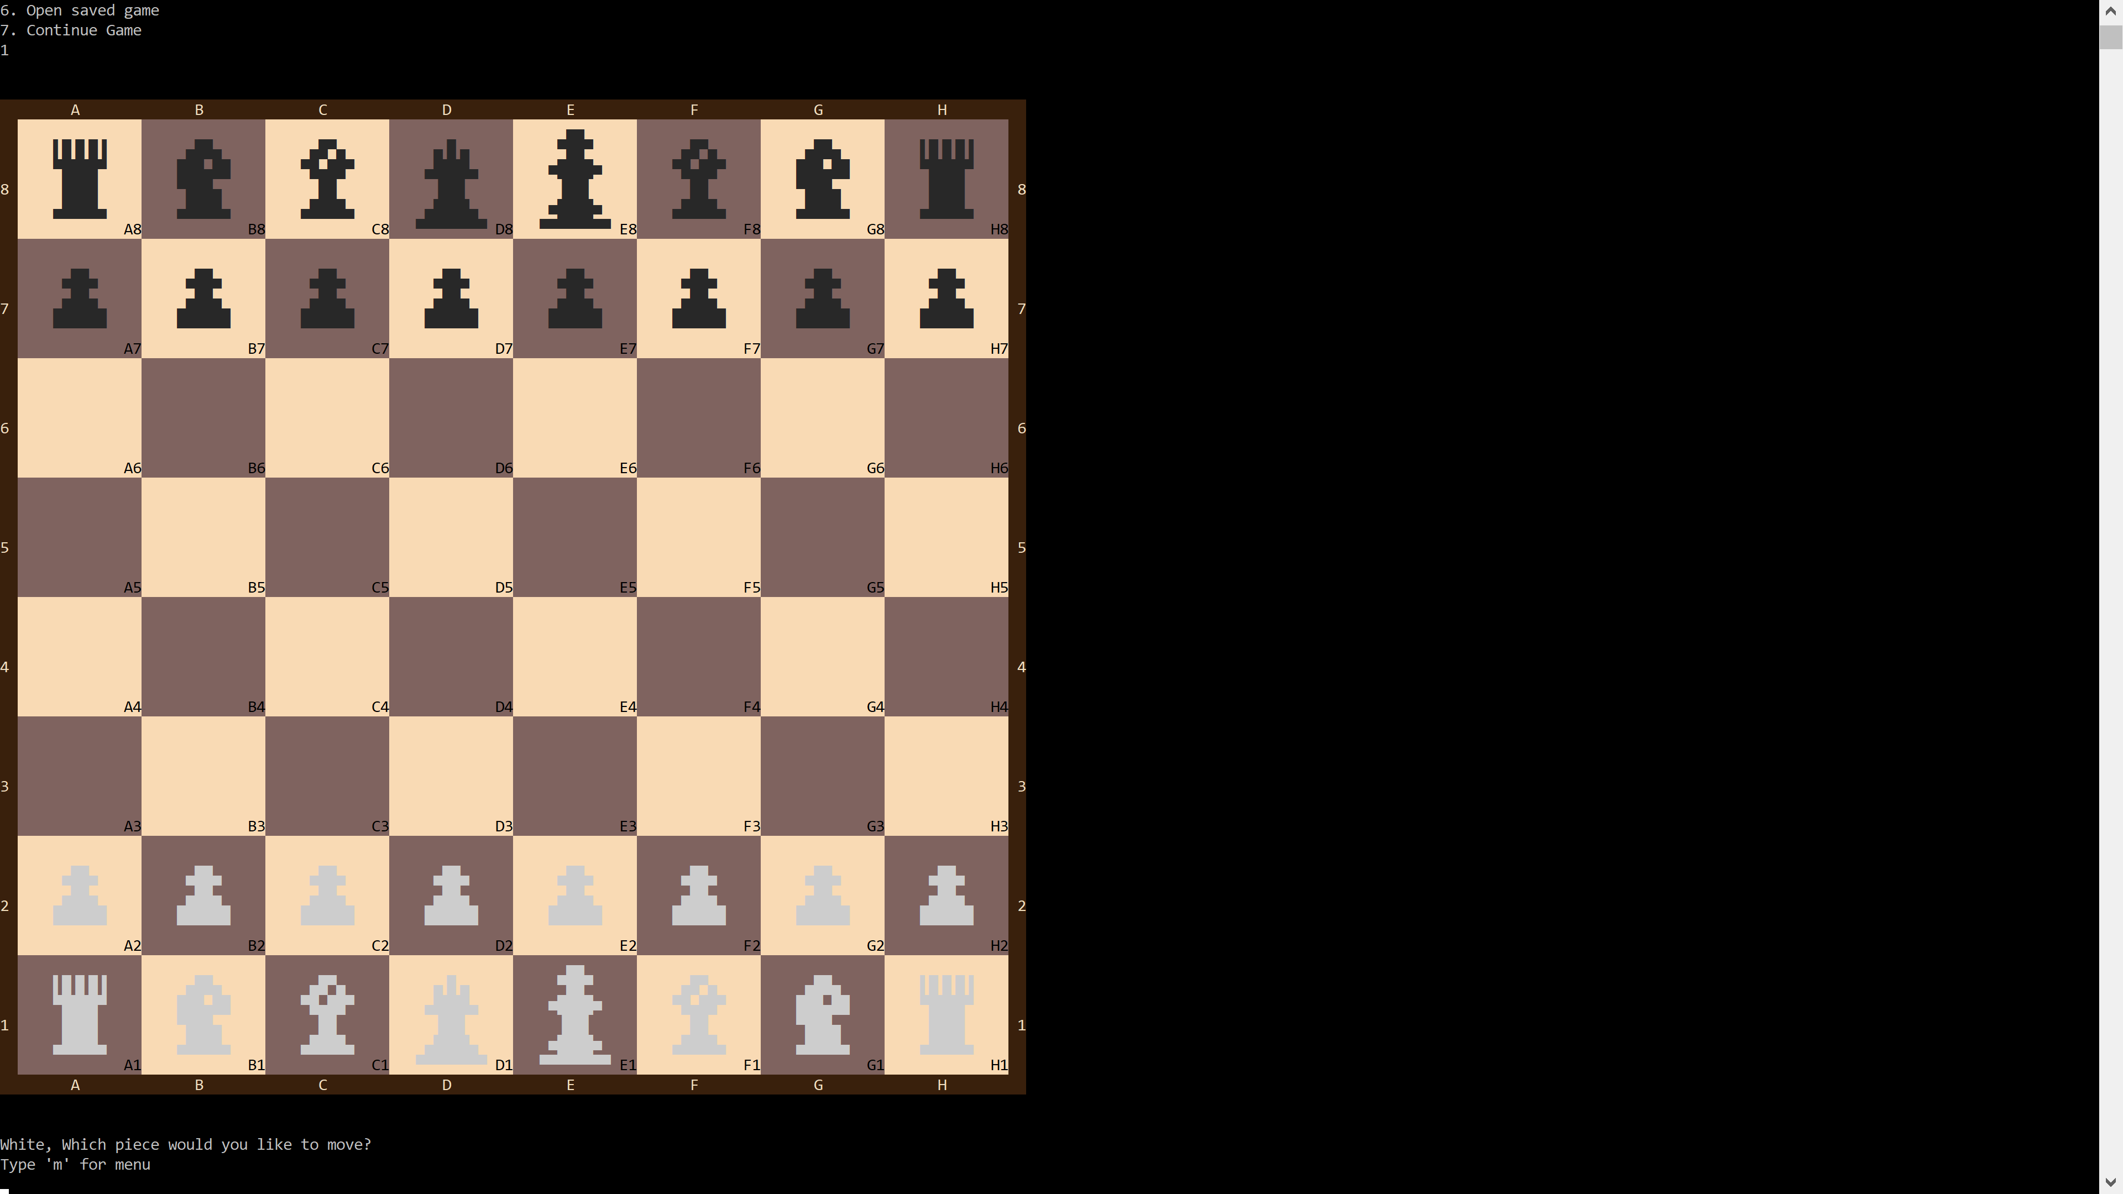
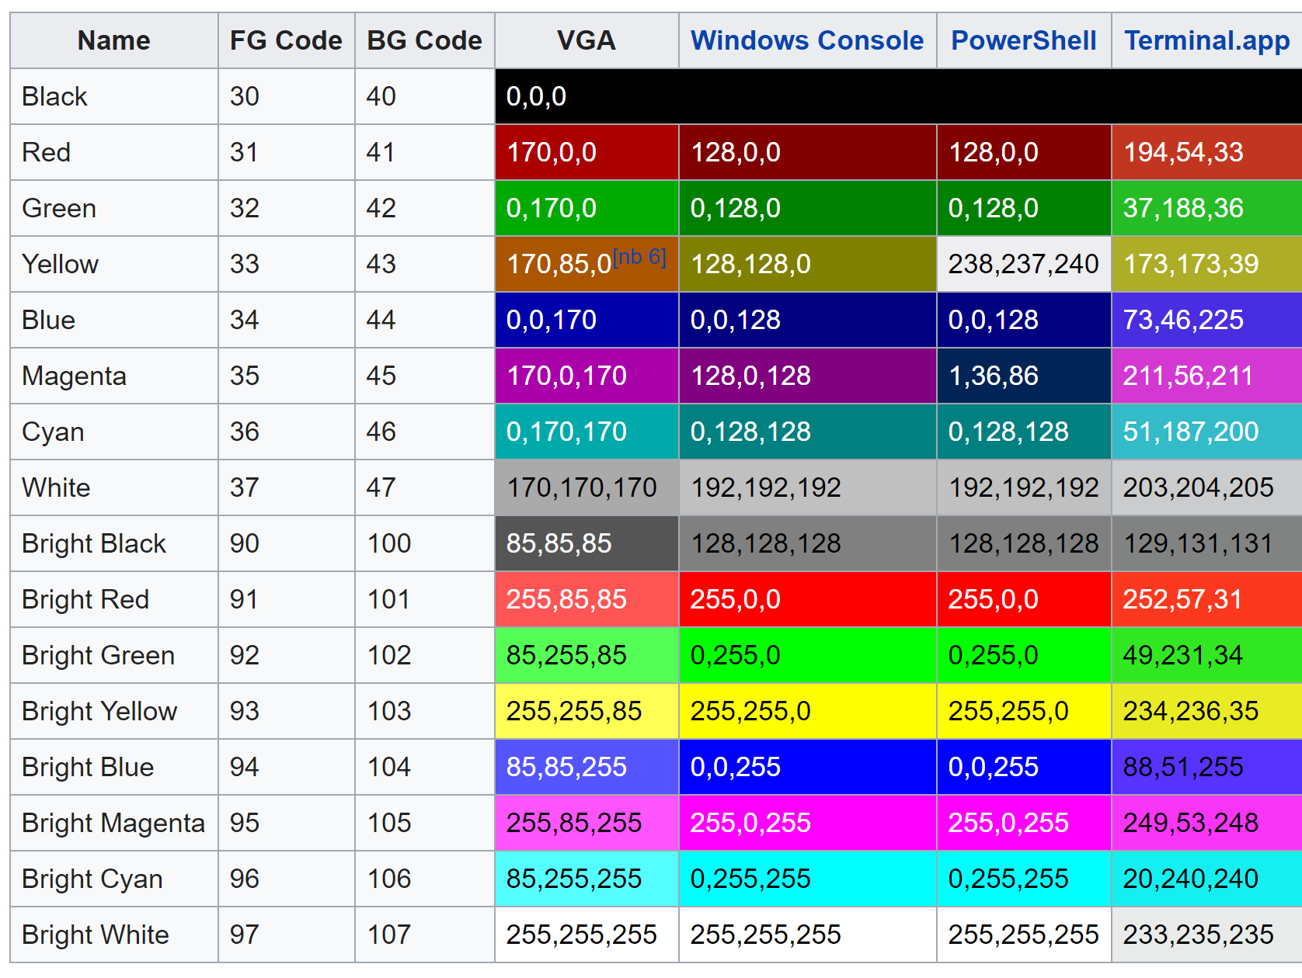
color display
All major CLI’s conform to the ANSI Escape Sequences
Part of ANSI is colors
Windows does not work well with escape sequences so we use JANSI
This gives a much nicer “graphic” board
With JANSI
Without

Slide 37
TAKEAWAYS
PLANNING
TESTING
CODE REUSE

Slide 38
planning
The ChessBoard class was created last minute
The code was constantly being restructured
Unforseen infrastructure kept popping up
All of this could have been avoided if we paused before started and came up with a plan

Slide 39
testing
The pawns constantly gave us issues
The inCheck method worked sporadically
We were constantly stepping through code
If our project would have been test driven we could have avoided all these isssue

Slide 40
Code reuse
We were able to save time writing move check methods by recognizing that some pieces are a combination of other pieces
This is especially useful for fairy chess pieces
The network was able to act on the ChessBoard and therefore all it did was maintain a connection
AI were also able to make use of this without having to rewrite the ChessBoard methods

Slide 41

end

Slide 42


Slide 43
Stack overflow
After creating the ChessBoard class and refactoring we got a Stack Overflow
Very confusing because there is no recursion in the code
After stepping through the code the mistake became quite apparent
Remember how all pieces must pass four checks?
Turns out that’s not always true
Each piece must pass four move checks in order to move
Can the piece move in that way
Is there a piece in the way
Will it kill your piece
Will it leave your king in check

